Slide 1
SQL Programming
Transactions

Slide 2
Module 12: Transactions Page A-1: Intro
Most, if not all, of the programs that we’ve written have been simple, single-statement SQL programs.
These programs were written to perform a single task, and once they were executed, we were pretty much done.
But there are many occasions when the code we write will be part of a collection of statements. And in this module we consider some special features of SQL that allow us to gather up all of these statements and to treat them as a logical unit.
These logical clusters of code are referred to as transactions, and they are the focus of this module.

Slide 3
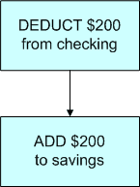
Module 12: Transactions Page B-1: ATM Example
Consider this typical banking ATM example.
A customer wants to transfer $200 from their checking account to their saving account.
As we consider this transaction (see the flowchart) we see that there are two parts to it:
taking money out of one account
putting money into the other
Both parts of the transaction must complete, in order for this process to be successful.
The customer wouldn’t appreciate it if the first step worked, but the second step did not, and the bank wouldn’t appreciate it if the second step worked but the first step didn’t.

Slide 4
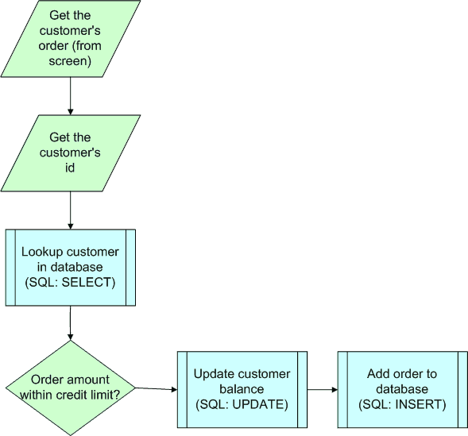
Module 12: Transactions Page B-2: Order Entry Example
As another example, consider a web-based application that handles our company’s order processing.
The flowchart symbolizes the steps involved in this process.
In this example, we have some other program (Java, Visual Basic, …) interacting with the user, and that program calls on SQL to interact with the database.
The web-interface will first request the items on the customer’s order, and then get the customer’s account number.
The account number will then be passed off to SQL to retrieve that customer’s record from the database.

Slide 5
Module 12: Transactions Page B-3: Order Entry Example
The amount of the order will be compared with the customer’s balance, and if the customer has not exceeded their credit limit, the order transaction will be processed.
The customer’s balance will be updated
An order will be posted in the database
These two actions must both complete in order for the transaction to be successful. All or nothing.
And as an aside, please notice, that the web-based application is interfacing with SQL to post these transaction to the database. SQL is handling all of the database interaction, while Java (or some other language) is handling the user interface and managing the interaction with SQL.

Slide 6
Module 12: Transactions Page B-4: ACID Test
Data sharing
Data consistency
Data integrity
Reduction in redundant data
On the face of it, transaction support is pretty trivial – just allow a bunch of statements to be clumped together.
But after some inspection, transaction level support is rather complicated, and it requires four specific properties of the database.
In addition to all of the other well-known features of a database, databases must also pass the ‘ACID test’ when it comes to transactions.
They must support these four features:
Atomic
Consistent
Isolated
Durable

Slide 7
Module 12: Transactions Page B-5: ACID: Atomic
The ACID Test:
Atomic
Consistent
Isolated
Durable
An atomic transaction is a logical transaction that cannot be further subdivided, or ‘cut up’.
By definition then, every statement in a transaction must be processed, each and every one, or none of them should be processed.

Slide 8
Module 12: Transactions Page B-6: ACID: Consistent
The ACID Test:
Atomic
Consistent
Isolated
Durable
Statement level consistency provides that all rows in the database that were candidates for ‘update’ at the time the statement started to execute, will be updated.
That is, each statement is guaranteed a consistent view of the database for the duration of its processing.
For example, let’s say we’re about to update the status of all 5000 Computer Science students (eg. UPDATE student SET .. WHERE major = ‘CS’).
There are quite a few majors, and this statement will take some time to process.
But while this processing is taking place, no one else will be able to interfere with this process. No new Computer Science students will be added during this update, no current CS majors will have their major code changed during the process.

Slide 9
Module 12: Transactions Page B-7: ACID: Consistent
The ACID Test:
Atomic
Consistent
Isolated
Durable
Transaction level consistency provides that all rows in the database that were candidates for ‘update’ at the time the first statement in the transaction started to execute, will be updated.
Other users won’t be able to ‘sneak in’ any changes in the time between when individual statements in the transaction are executing.
If we modify the preceding example to something like this:
UPDATE student
SET …
WHERE major =‘CS’
UPDATE transcript
SET …
WHERE major =‘CS’
where these two statements comprise a single logical transaction, then no one else on the system should be able to interfere with ‘candidate’ records (CS records in the student table, and CS records in the transcript table) during our processing.

Slide 10
Module 12: Transactions Page B-8: ACID: Isolated
The ACID Test:
Atomic
Consistent
Isolated
Durable
Changes to the database are isolated from all of the other users on the system, until the transaction is committed.

Slide 11
Module 12: Transactions Page B-9: ACID: Durable
The ACID Test:
Atomic
Consistent
Isolated
Durable
Changes to the database are permanent.
Once a transaction has been committed, the database ‘knows’ that fact, and appropriate safeguards will be in place to insure that regardless of the failure, a database can recover all intact (committed) transactions.

Slide 12
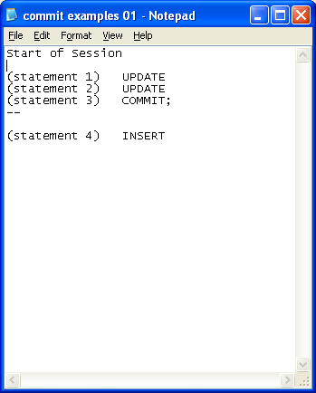
Module 12: Transactions Page C-1: Commit
A transaction is a collection of statements that should be treated as a logical unit of work.
So we need some means of identifying the boundaries, or the beginnings and ends of transactions.
The COMMIT statement is used to mark the end of a transaction.
In this regard, a COMMIT statement, commits, or makes permanent, all of the changes that have been made against the database, since the last COMMIT command.
In this example, the results of the two update statements (statements 1 and 2), are committed to the database by the single COMMIT command (statement 3).
Once committed, the changes are made ‘public’ to the database community.

Slide 13
Module 12: Transactions Page C-2: Commit
The INSERT statement (statement 4) has not yet been committed so its impact on the database remains isolated.
That is, the row(s) of data that were inserted into the table are available only to this local user during this session. Those new rows of data are not yet available to the database community pending a commit.

Slide 14
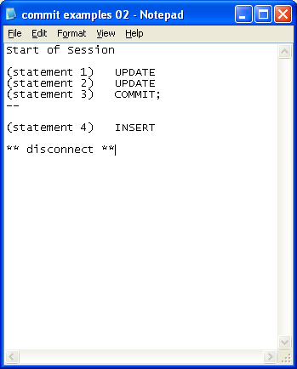
Module 12: Transactions Page C-3: Oracle Exit
What happens if the user disconnects from the database without issuing a commit? Each vendor handles this situation in their own fashion.
In regard to the Oracle environment, if the user disconnects ‘cleanly’, then Oracle will issue a commit on their behalf, and the INSERT statement (4) will be committed to the database. This is referred to as an implicit commit.
A clean disconnect occurs when the user explicitly logs off the system, or, in the iSQL*Plus environment, a clean disconnect occurs when the user exits (File – Exit) the browser.
If the user closes the browser (via the icon in the upper right-hand corner of the screen), the session is considered ‘aborted’, and any uncommitted transactions are discarded.

Slide 15
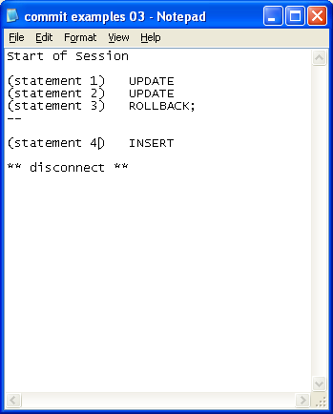
Module 12: Transactions Page C-4: ROLLBACK
The ROLLBACK statement undoes any changes-in-progress (ie, changes that have not yet been committed).
In this example, the ROLLBACK statement (statement 3) undoes both of the preceding update commands (statements 1 and 2).
And, upon a clean disconnect from the system, only the INSERT statement (4) will be committed.

Slide 16
Module 12: Transactions Page C-5: SAVEPOINTs
The scope of the ROLLBACK statement is all the way back to the last COMMIT. But I can imagine a number of scenarios where the user might want to undo only the last command.
SAVEPOINTs are a mechanism that provide the user/programmer with additional flexibility when it comes to transaction control.
What a savepoint does is provide a label, or bookmark, for a place in the transaction.
The syntax for the SAVEPOINT command is simply:
SAVEPOINT savepoint_name;

Slide 17
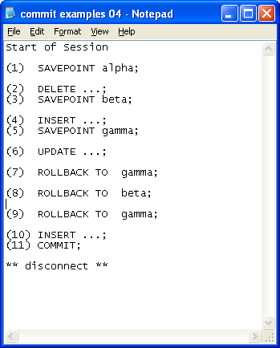
Module 12: Transactions Page C-6: SAVEPOINTS
AT the start of this session, a SAVEPOINT command is issued that defines a bookmark, named alpha.
A DELETE statement is issued and some rows are removed from the table. These deletions are isolated from other users until they are committed.
Another bookmark, or placeholder is named in the job stream: beta.
AN INSERT command is issued and rows are added to a table. These changes are isolated and temporary, until a commit is issued.
Adding yet another bookmark – gamma.
And updating rows in a table.

Slide 18
Module 12: Transactions Page C-7: SAVEPOINTS
The user/programmer issues a rollback to location gamma. This rollback undoes the update changes that were made in step 6. This rollback only goes back to location gamma, and the preceding DML commands (2, 4) are intact (but still pending a commit).
The user/programmer issues another rollback, this time to location beta. Now the inserts that had been performed at step 4 have been undone.
The user/programmer issues a rollback to gamma. Ooops! Gamma does not exist in the jobstream anymore, and this command will throw an error. When the rollback was issued at step 8, it undid steps 5 and 4. Hence, the savepoint that had been defined in step 5 was removed.
Rows of data are inserted into a table.

Slide 19
Module 12: Transactions Page C-8: SAVEPOINTS
All of the pending changes in this session are committed.
So, which DML commands are ‘applied’ in this transaction?

Slide 20
Module 12: Transactions Page C-9: SAVEPOINTS
All of the pending changes in this session are committed.
So, which DML commands are ‘applied’ in this transaction?
Certainly the INSERT statement at step 10.

Slide 21
Module 12: Transactions Page C-10: SAVEPOINTS
All of the pending changes in this session are committed.
So, which DML commands are ‘applied’ in this transaction?
Certainly the INSERT statement at step 10.
And also the DELETE statement at step 2.
And that's it.

Slide 22
Module 12: Transactions Page D-01: Concurrent Access
In a multi-user environment, it is perhaps inevitable that at some point in time, two different processes will attempt to request the same records in the database.
And if the database can guarantee that transactions are indeed processed in isolation, then we’ll be okay.
Conceptually, what we’d like to see is some mechanism that stacks up all o f the pending transactions, so that each transaction is processed fully, before the DBMS moves on to the next one.
This ‘solution’ suggests that transactions could be processed in a serial fashion, hence we refer to this technique/concept as the ‘serializability’ of transactions.

Slide 23
Module 12: Transactions Page D-02: Concurrency Control
So how do we achieve serializable transactions?
Generally by using some form of locking mechanisms.
In its most simple incarnation, any data that are to be accessed, get flagged as “in use”, or “locked”, for the duration of the transaction.
And if we think of the DBMS as the gatekeeper, we can rely on the DBMS to not share, or pass along, any data that is presently “locked”.

Slide 24
Module 12: Transactions Page D-03: Granularity
We recognize that the success of user throughput depends in large measure on the locking ability, or the granularity of the locks, that the database can impose.
Database Level – a database lock essentially locks down the entire database for the duration of each and every transaction. So, while Transaction A is running, all other transactions would be queued until “A” completes.
If the database were ‘small’ and had only a few users, this might be acceptable. And this kind of locking was common place in the early days of pc-level database applications.
But this would be impractical for any ‘real’ database application, and about the only time a full database lock would be called for might be if the entire database were being backed up.

Slide 25
Module 12: Transactions Page D-04: Granularity
Table Level – a table lock, locks down the entire table for the duration of the transaction. No other transaction is permitted to access any of the rows in this table until the transaction that placed the locks finishes up.
This might be ‘okay’ for transactions that are applied against infrequently accessed tables, but imagine the consequences if this were applied to a frequently accessed table.
For example, I would imagine in a student records application that the STUDENT table would be used in almost all of the queries. In this example, whenever any query accessed the STUDENT table, all of the other queries that referenced that table would queue until the original completed. This could drag performance and throughput to a standstill, and I would hope that the DBMS could provide a more fine-tuned level of locking than something this ‘gross’.

Slide 26
Module 12: Transactions Page D-05: Granularity
Page Level – a page lock is related directly to the physical storage device that is used to store the database data, and it allows for locks to be imposed at the block/page/sector level for those items that contain records that are “in process”.
Only these blocks/pages that contain records “in process” are locked from access by other database processes.

Slide 27
Module 12: Transactions Page D-06: Granularity
Record Level – permit locks to be applied to the row/record level in the database.
Any other row in the table, not being accessed by a transaction, remains available to other transactions.
Field/Column Level – provide a level of granularity that only locks down the columns in a row that are actually being accessed by the transaction. The other columns in the row are available to other processes.

Slide 28
Module 12: Transactions Page D-07: Granularity
Each database follows its own guidelines as to when and how to lock down data.
Additionally, database vendors provide locking mechanisms that allow the programmer to explicitly specify the locking level that his/her application requires.

Slide 29
Module 12: Transactions Page D-08: Oracle Locks
In the Oracle 10g environment, by default, Oracle imposes a row-level lock for DML statements.
No other user can change these rows until that lock is released.
In Oracle parlance, this is a shared lock which permits other users to view the data in the tabe, but they cannot change any of the data in the rows that are locked, nor may they alter the structure of the table.

Slide 30
Module 12: Transactions Page D-09: Oracle Locks
In the fine print of that previous description is the notion that Oracle’s focus is on rows that are about to be changed, not necessarily rows that are ‘merely’ accessed.
So you should notice that SELECTing rows doesn’t place locks on those rows.
But what happens if you SELECT some rows, evaluate them in some fashion, and then decide to UPDATE them? There is a danger that some other process might creep in while your process is ‘evaluating’ those rows, and change them out from underneath you.
Oracle gives the programmer a way to place a shared lock on a SELECT statement, by appending the clause ‘FOR UPDATE’.
For example
SELECT …
FROM …
WHERE …
FOR UPDATE;

Slide 31
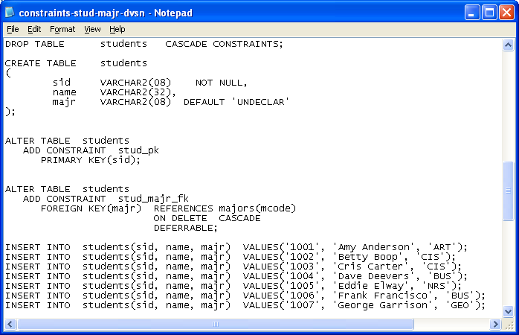
Module 12: Transactions Page E-1: Constraints
Sometimes, during transaction processing, it may be necessary to turn off a constraint.
Your database may have co-existing constraints that require elements in a pair of table to ‘coexist’.
For example, the campus might have a rule that prohibits a major from existing unless there are students in that major. Similarly, a student might not be allowed to choose a major, unless it’s a valid major.
We seem to be in a Catch-22 situation. How can we ever add new majors?

Slide 32
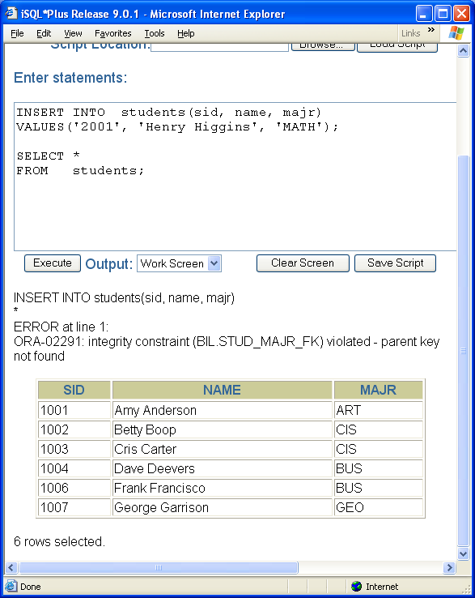
Module 12: Transactions Page E-2: Constraints
We need to be able to temporarily defer the checking of majors and major codes until after the transaction has completed.
Attempts to insert rows in the student table, with major code values that cannot be found in the majors table, are rejected.
But, we can ‘defer’ the constraint, and as long as all constraints can successfully be applied at the end of the transaction, everything will ‘work’.

Slide 33
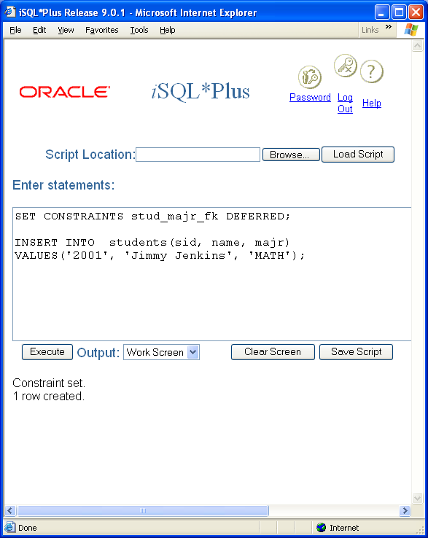
Module 12: Transactions Page E-3: Constraints - Deferred
Updates will be permitted, but at the completion of the transaction, everything must be in order.

Slide 34
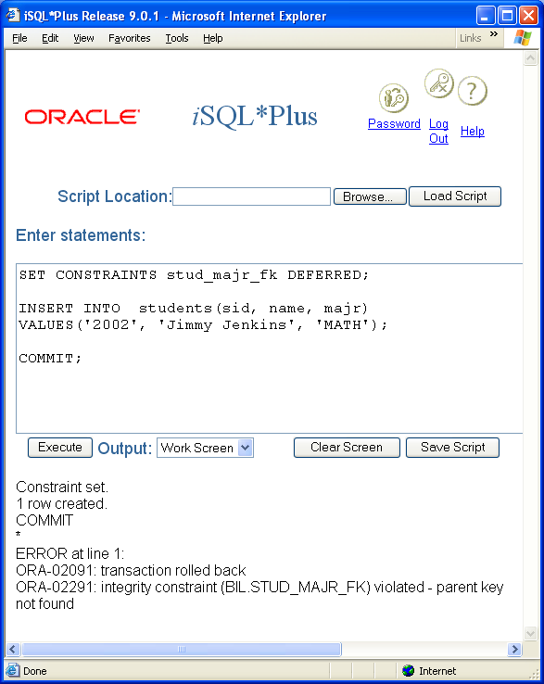
Module 12: Transactions Page E-4: Constraints - Deferred
If we attempt to COMMIT this transaction, without having created the corresponding major table entry, the commit statement will fail, and the INSERT (for Jimmy Jenkins) will be rolled back.

Slide 35
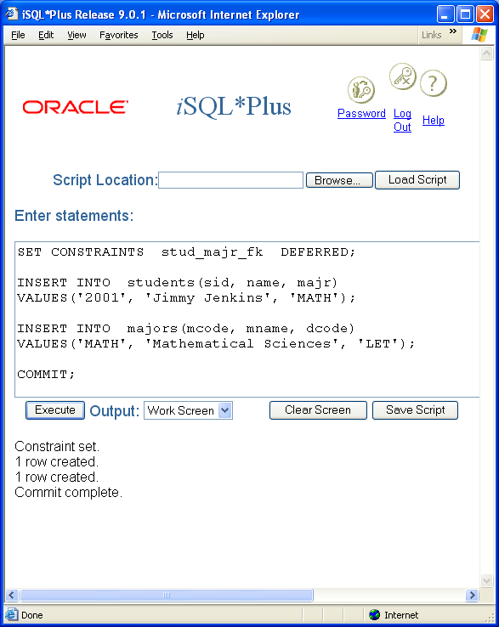
Module 12: Transactions Page E-5: Constraints - Deferred
As long as everything is in order by the end of the transaction (ie. By the time we COMMIT our changes to the database), the changes will be committed.

Slide 36
Module 12: Transactions Page E-6: Constraints
Sometimes during transaction processing it may be advantageous to drop, or disable, a table constraint.
Each time an insert is issued, or an update is processed, the table constraints are checked. This process of checking the constraints may impede performance, and there may be times when the user/programmer may be justified in ‘bypassing’ or disabling the constraint for the duration of a particular transaction.
Consider the student table, as we last left it. This table had a foreign key reference constraint that would check all major codes in the student table against the major code column in the majors tables.

Slide 37
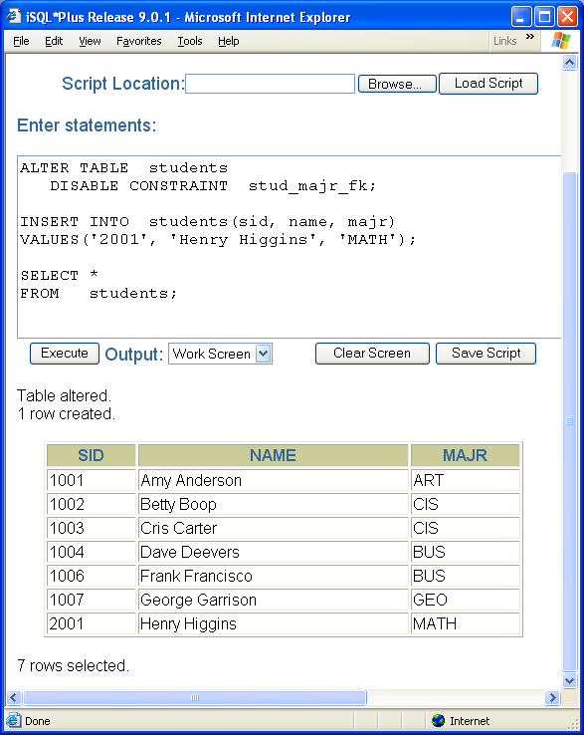
Module 12: Transactions Page E-7: Constraints
The foreign key constraint can be turned off temporarily by altering the table, and disabling that constraint.
The syntax for this command is:
ALTER table_name
DISABLE constraint_name;
And once disabled, that constraint is not checked.
The advantage to disabling a constraint rather than outright dropping the constraint, is that the constraint definition remains in the database. It is just flagged as inactive, or disabled.

Slide 38
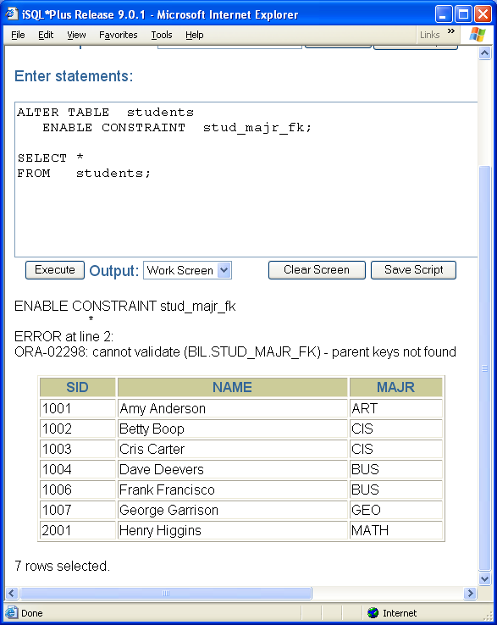
Module 12: Transactions Page E-8: Constraints
Disabled constraints can be reactivated by enabling them.
The syntax for enabling a constraint is:
ALTER TABLE table_name
ENABLE constraint_name;
If any of the rows in the table contain data that violates the enabled constraint, the ENABLE command throws an error.

Slide 39
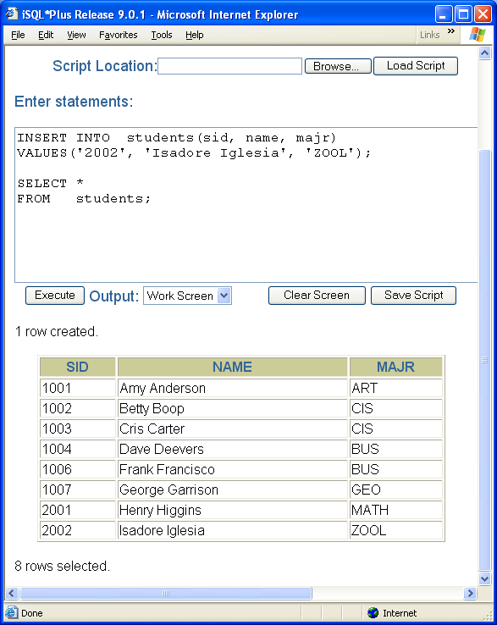
Module 12: Transactions Page E-9: Constraints
As you can see in the example, invalid major codes are still permitted in the students table because the ENABLE option was not successful.

Slide 40
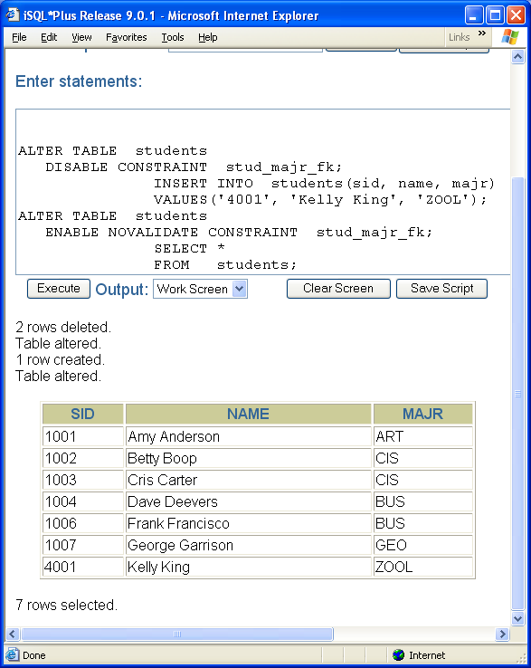
Module 12: Transactions Page E-10: Constraints
Leaving the table in this state is rather dangerous. I mean, the point of defining constraints in the first place was to help insure data integrity. While the constraint is disabled, erroneous data can find its way into the database.
Using the NOVALIDATE phrase, turns on, or enables the constraint, without checking existing data in the table. In this case, we see that Kelly the ZOOLogy major is still in the table, even though ZOOL is an invalid major code.

Slide 41
Module 12: Transactions Page F-1: Oh by the way
In this first example for section D (see slide D-1), I introduced a new feature in the ALTER .. CONSTRAINTS clause – the DEFERRABLE phrase.
I would have mentioned it at the time, but I didn’t want to get off the topic. So, here we are.
In order to defer constraints, they must be deferrable. Constraints can be defined as deferrable, at the time you create them by using the DEFERRABLE phrase, as demonstrated in the example ;-)
I hope that covers all the loose ends, but I trust you’ll let me know, …

Slide 42
Module 12: Transactions Page T-1: Terminology
ACID:
Atomic
Consistent
Isolated
Durable
ROLLBACK
COMMIT
Explicit commit, implicit commit
SAVEPOINT
DEFERRABLE
DISABLE
ENABLE
ENABLE VALIDATE
ENABLE NOVALIDATE

Slide 43
Module 12: Transactions Page Z-1: End Notes
Please drop me an email if you noticed any errors in this module. I’d also appreciate reading your comments, criticisms, and or suggestions as to how this module could be improved.
Were there any gaps in the information that was presented (ie. ‘leaps of faith’)?
Was any section unclear?
Did I happen to do a good job? ☺
Thanks,
bil

Slide 44
That’s All

